Slide 1

Bugle
Making a Difference Just Got Easier!
Team: Sachin Kumar, Sumit Srivastava, Pooja Gosavi, Nida Syed, Lin Zhu, Shyam Ramakrishnan, Cameron Harris
Notes:
[Nida]

Slide 2
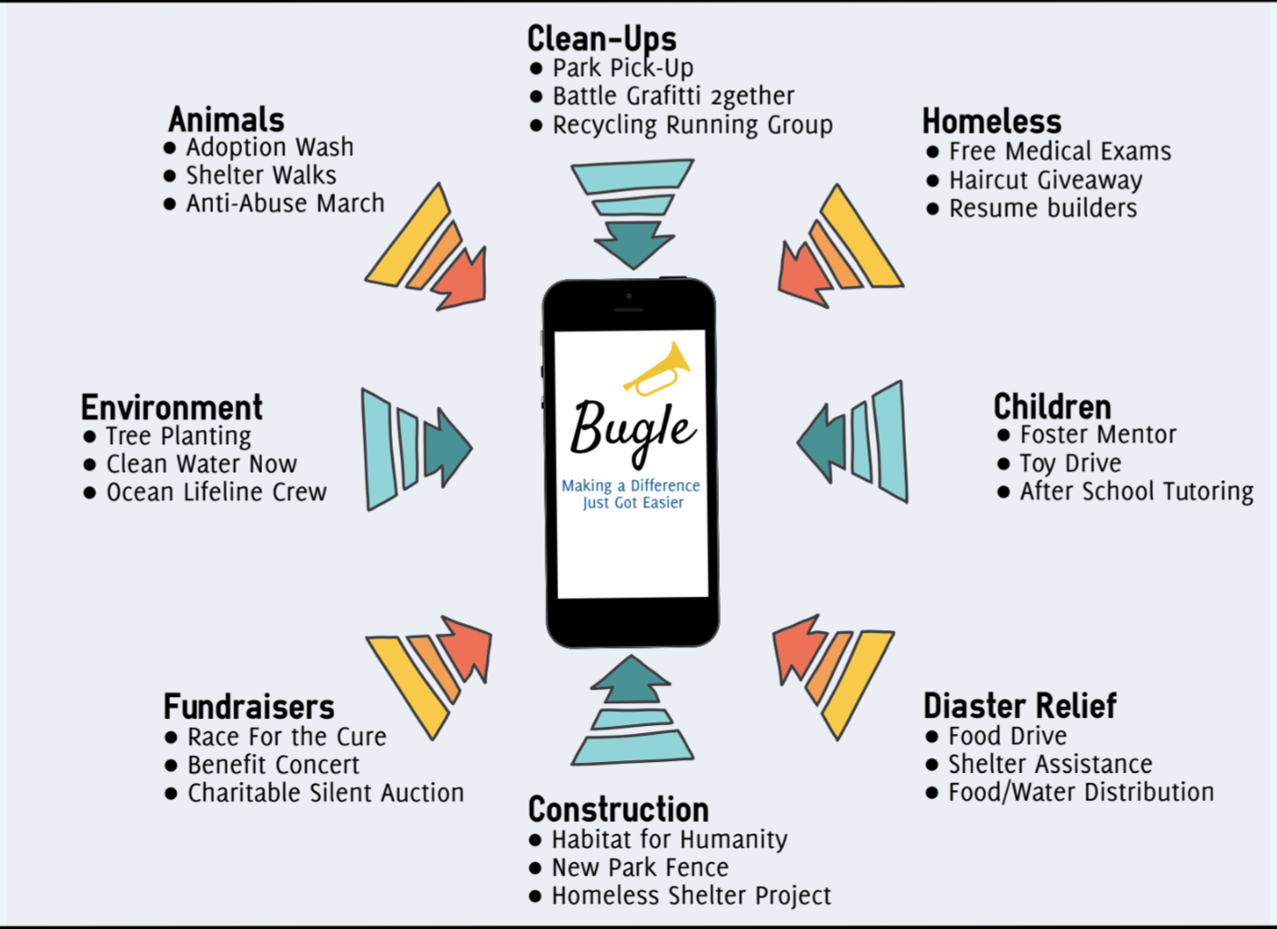
Bugle: Introduction
Non-profit organization which helps volunteers connect with organizations.
Developing a mobile website (Beta version).
Notes:
[Nida]
General introduction about Bugle and what we are doing - refresher
Chat, map location

Slide 3
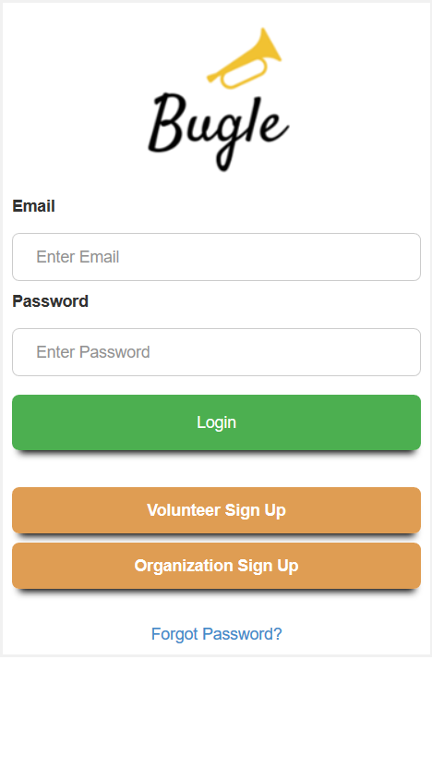
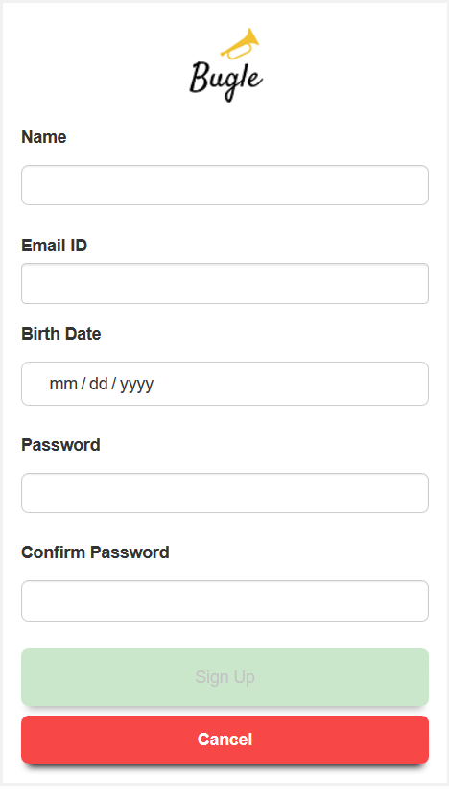
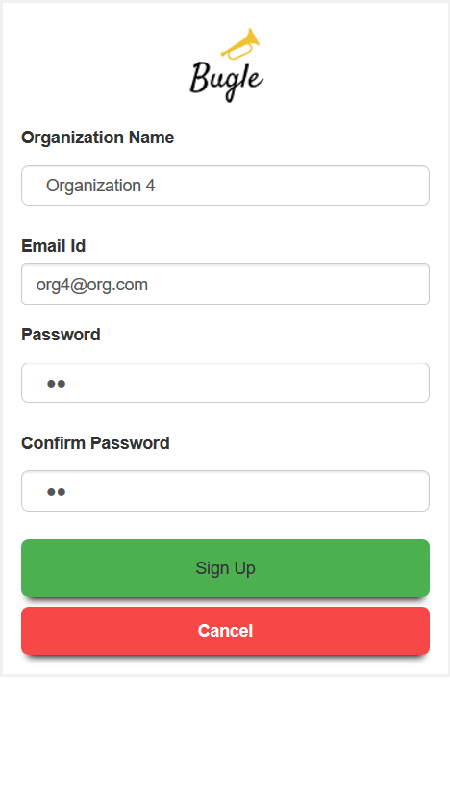
Bugle: Screens - Login and Sign Up
Login
Volunteer Sign up
Organization sign up
Notes:
[Sachin]
The Login screens. We can start describing a logical flow of the application from here.
Signup screens.

Slide 4
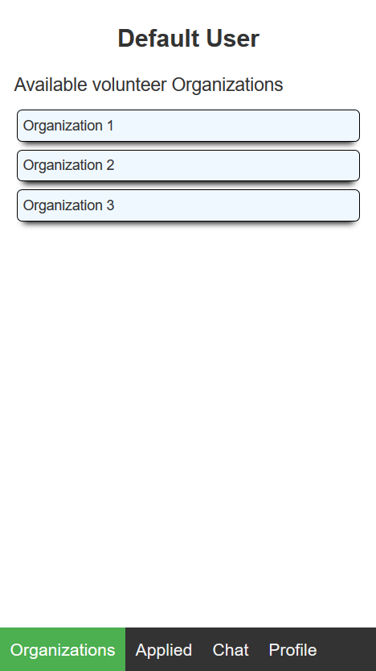
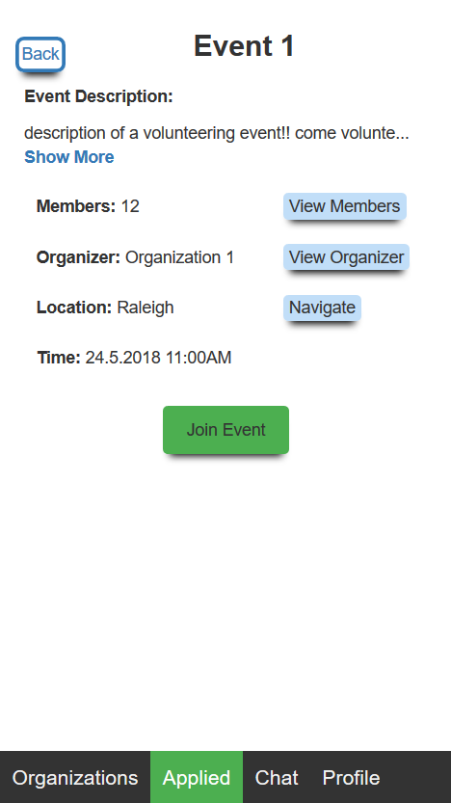
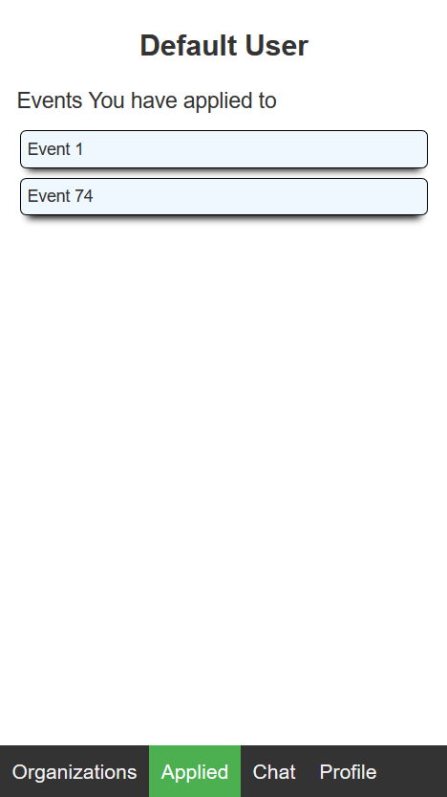
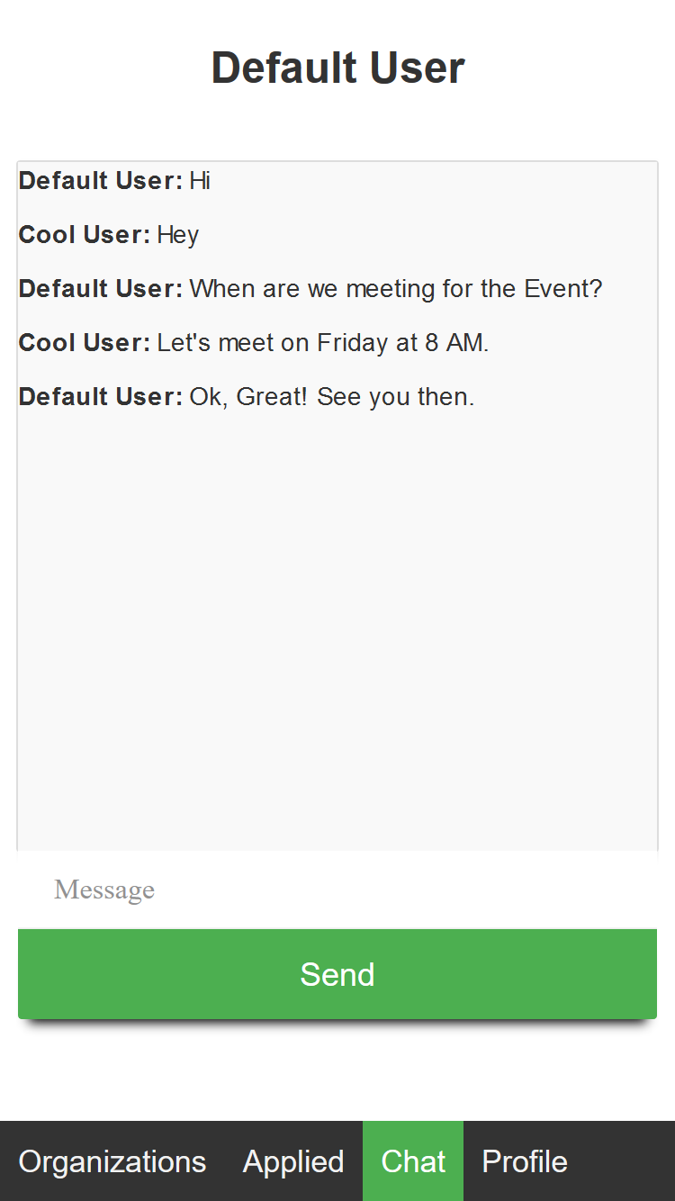
Bugle: Screens - Volunteer Pages
Volunteer Home Page
Event Details Page
Applied Events Page
Chat Page
Notes:
[Pooja]
We can continue describing the flow and describe the Volunteer pages and what all he can do.
Chat - Currently working on. We are working on implementing the Chat groups and persistence of chats.
On tapping on a particular event on applied events page, the user can again see the event details without the Join Event Button.
We are currently working on replacing this with “Show Chat” button.

Slide 5
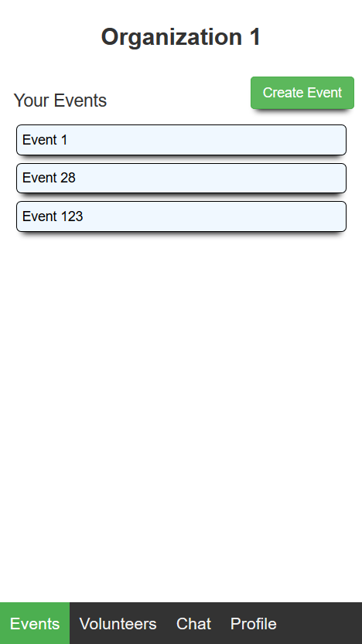
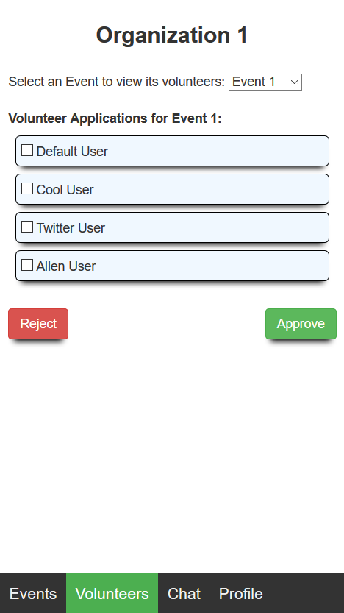
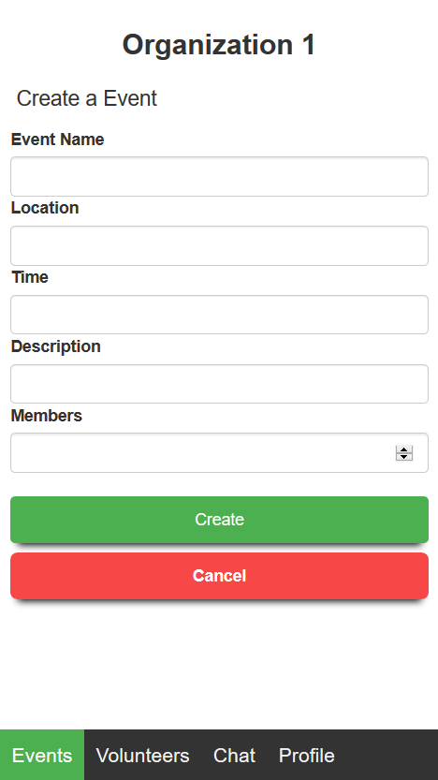
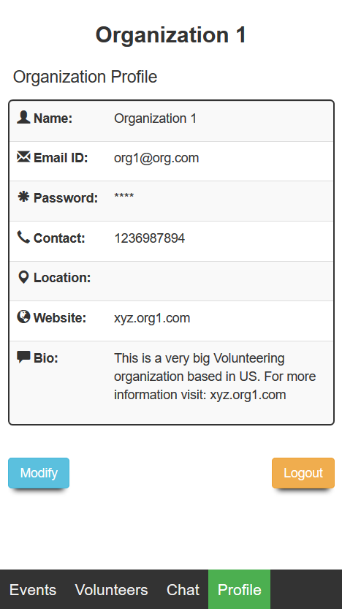
Bugle: Screens - Organization Pages
Organization Home Page
Event Volunteers Page
Create Event Page
Profile Page
Notes:
[Cameron]
Then we can move on to the Organization pages and describe the flow for that.

Slide 6






Bugle: Technology Stack
DB
WebSocket Framework
UI Server
Deployment Server
Database Server
Front End
Notes:
[Shyam]
The Technology stack we are using:-
Frontend: AngularJS
Frontend Server: Express - Middleware server
Backend Server: Play framework - Open source web framework -
Deployment Server: Heroku
Database: PostgreSQL - Initially used SQLite, but we switched since it is in-memory and Heroku terminates idle applications, so all the data is lost. PostgreSQL actually saves the data as files, so data is retained.
Chat Service: Socket.io - async chat service

Slide 7
Demo!
Notes:
[Sumit],[Lin]
demo

